Slide 1
Multi-objective Particle Swarm Optimization
Rebecca Miao
04/16/2020

Slide 2
Outline
Particle Swarm Optimization (PSO)
Concept
Algorithm
Multi-objective PSO
Algorithms
Quick View of NSGA II
Multi-objective PSO vs NSGA II
Concepts
Examples

Slide 3


1. Particle Swarm Optimization (PSO)
Inspiration: the algorithm mimics the navigation and foraging of a flock of birds or school of fishes
Notes:
Structure of the algorithm and its mathematical equations. .
insipiration

Slide 4
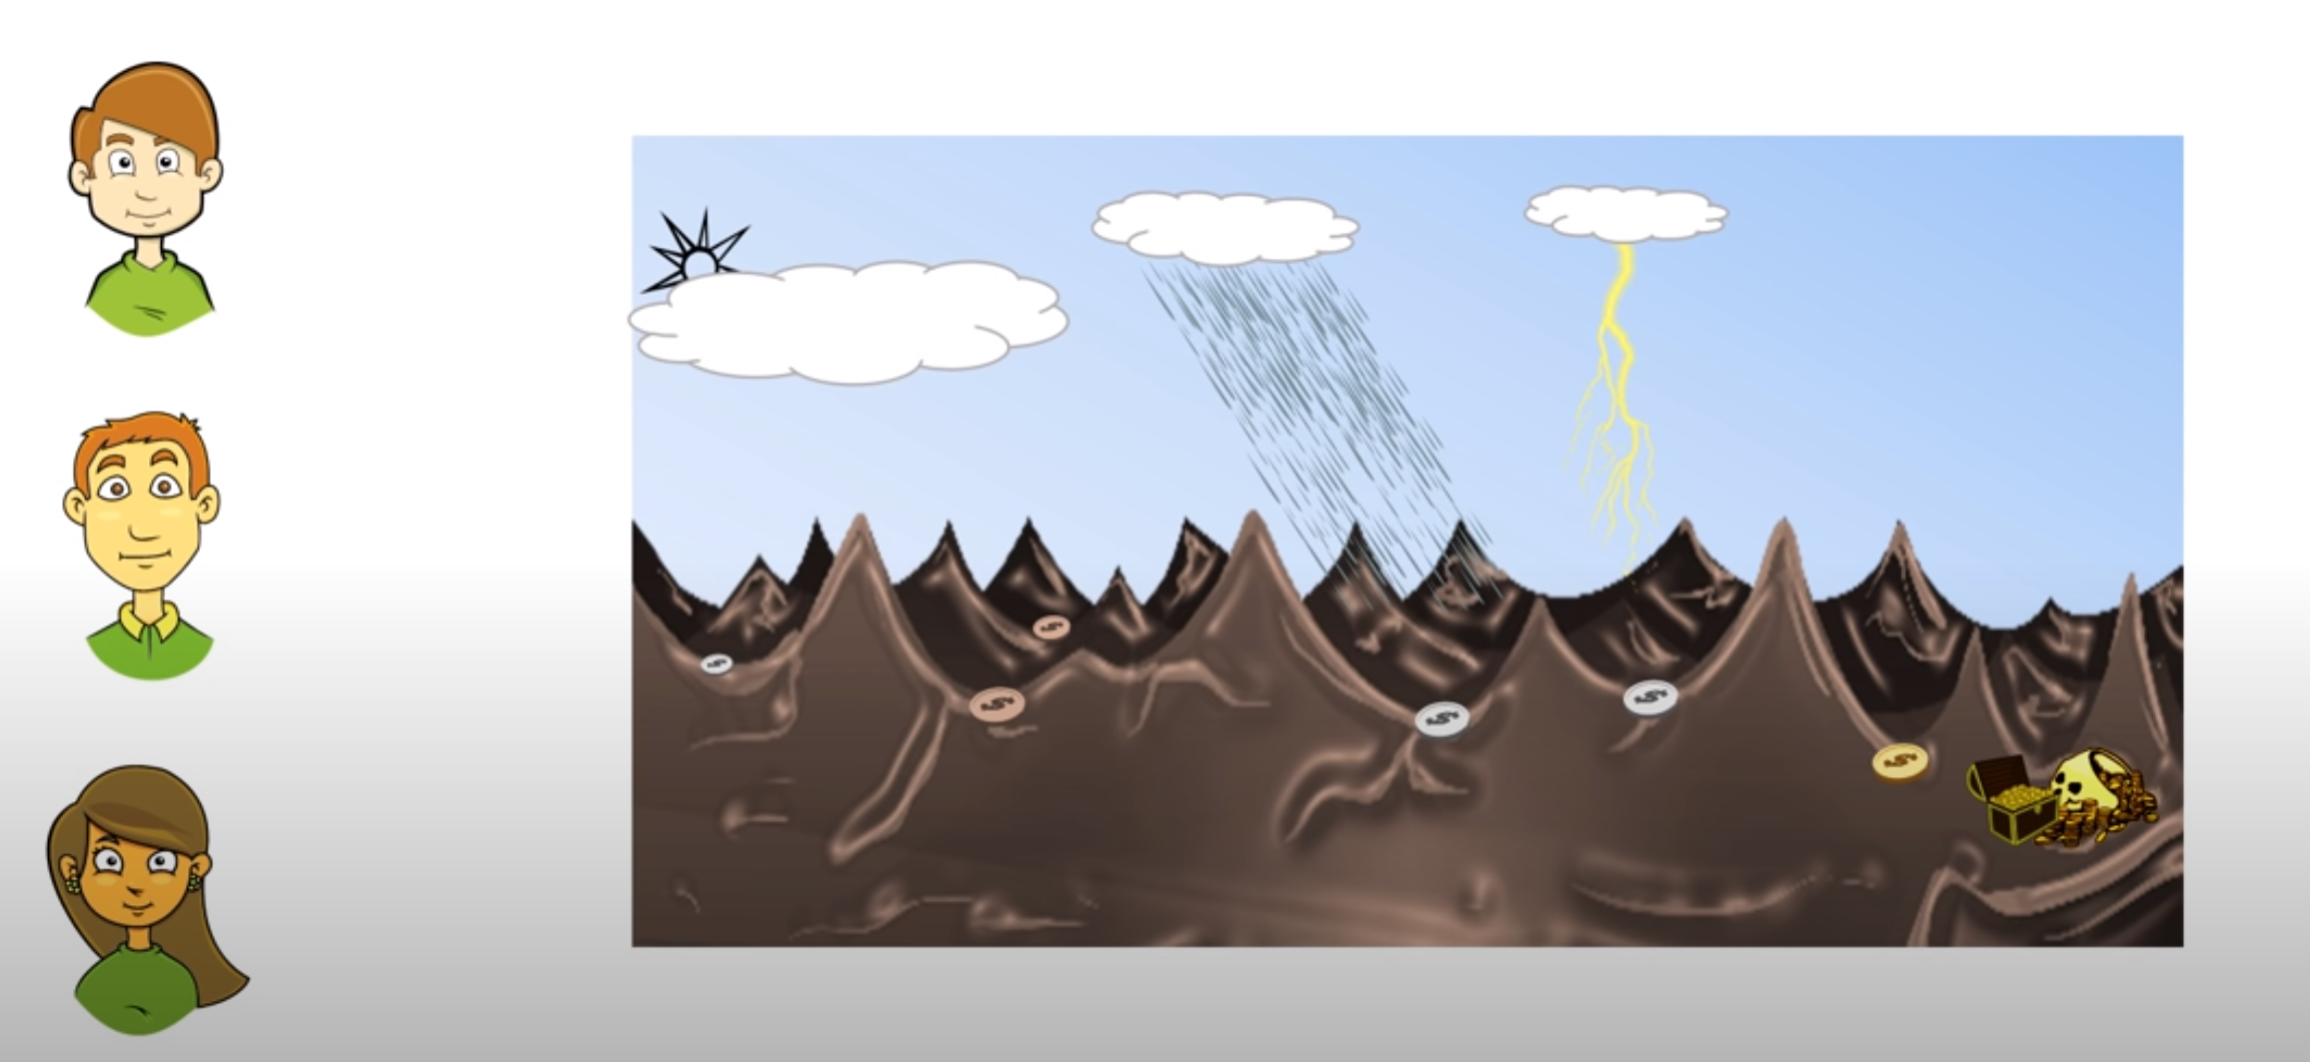
1. Particle Swarm Optimization (PSO)
Analogy of PSO search strategy
Timur
Zhenyi
Rebecca
Notes:
A mountainout region and team is about to start the search. Use PSO technique to look for the treasure in this case

Slide 5
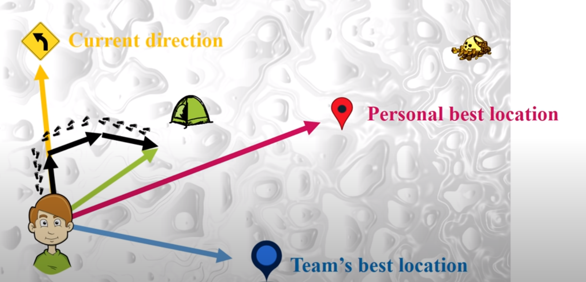
1. Particle Swarm Optimization (PSO)
Analogy of PSO search strategy
RULES:
Personal Best Location(10 km)
Team Best Location(10 km)
Current Directions(10 km)
Day T
Notes:
Contour map, treasury in on the valley on the right side
Each visitor needs to report the deepest valley they visited so far
Best position for the entire team
Start with random directions. Need it to find the next step
After three movements, Timur needs to report whether he will update personal best location & team;s best location

Slide 6
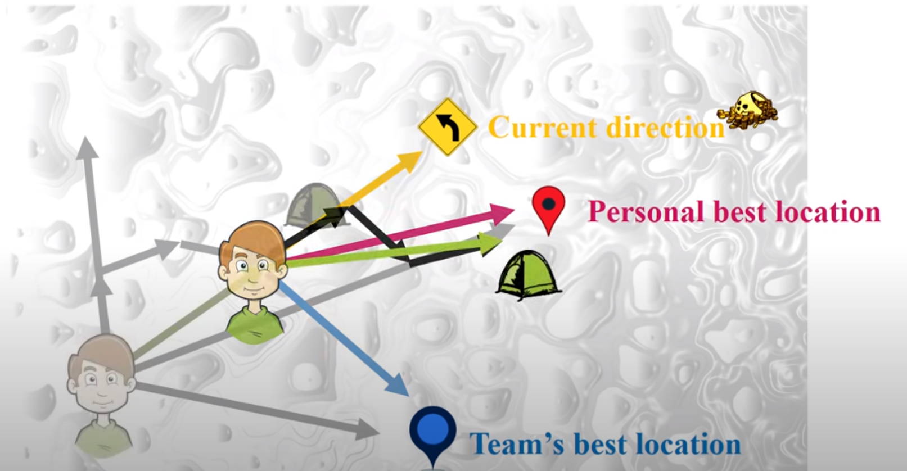
1. Particle Swarm Optimization (PSO)
Analogy of PSO search strategy
Day T+1:
If no updates for personal best location and team’s best location

Slide 7
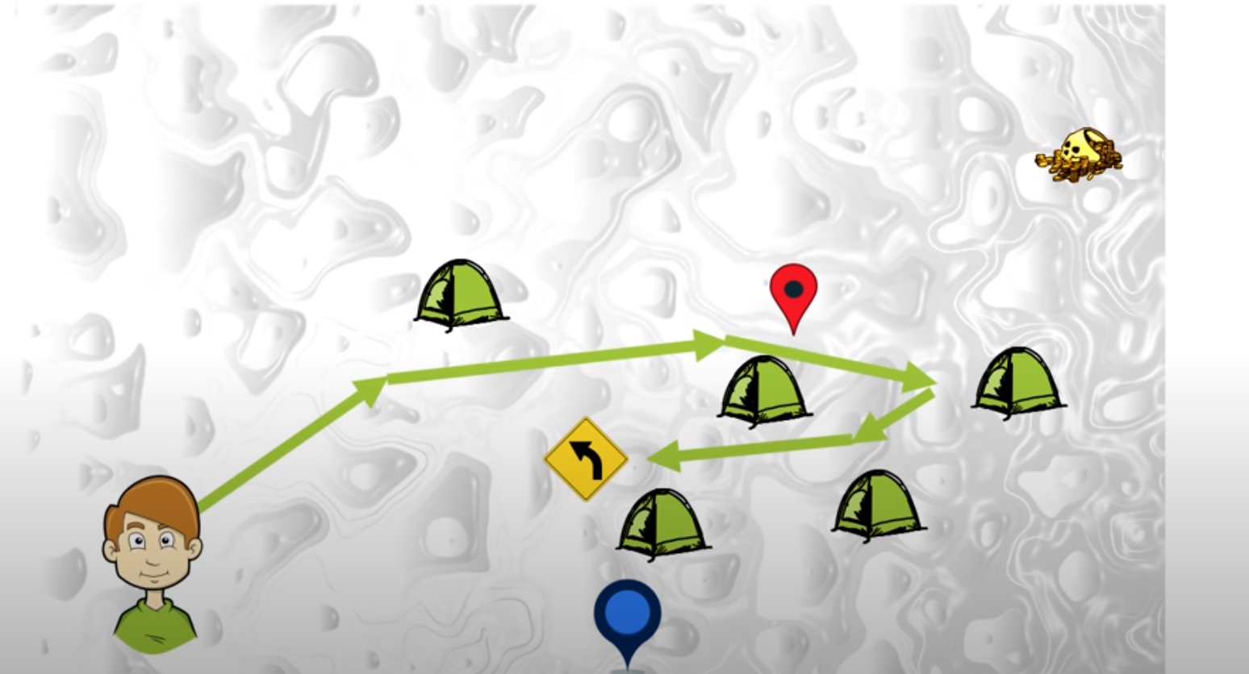
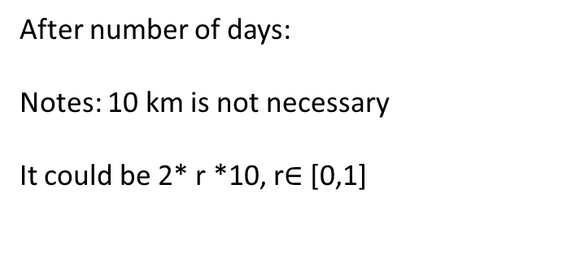
1. Particle Swarm Optimization (PSO)
Analogy of PSO search strategy
After number of days:
Notes: 10 km is not necessary
It could be 2* r *10, r$∈$ [0,1]

Slide 8
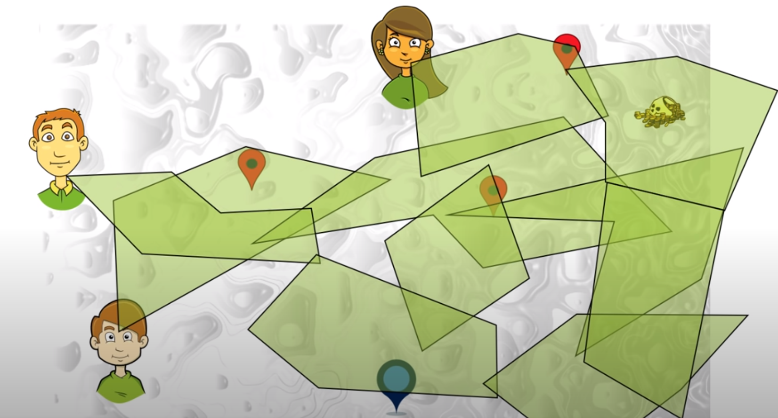
1. Particle Swarm Optimization (PSO)
Analogy of PSO search strategy
After number of days:
Timur is not alone,
He has team members!
Note: reducing walking distance
As day number increases
Notes:
Team is really likely to find the treasury
2. note

Slide 9
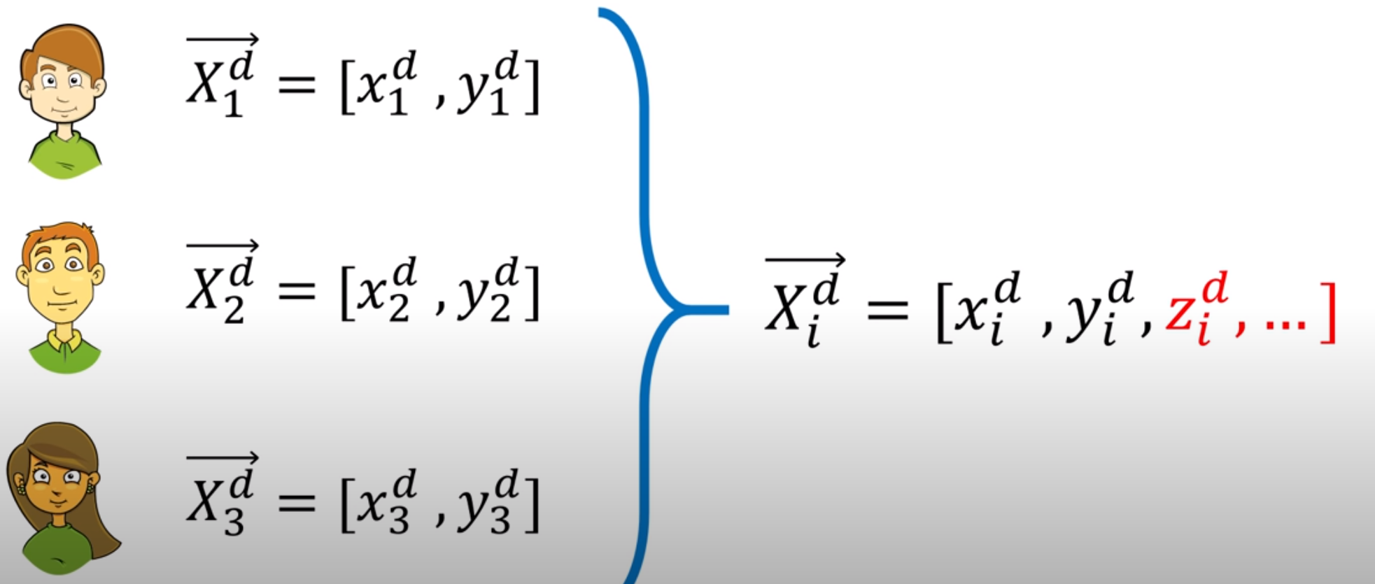
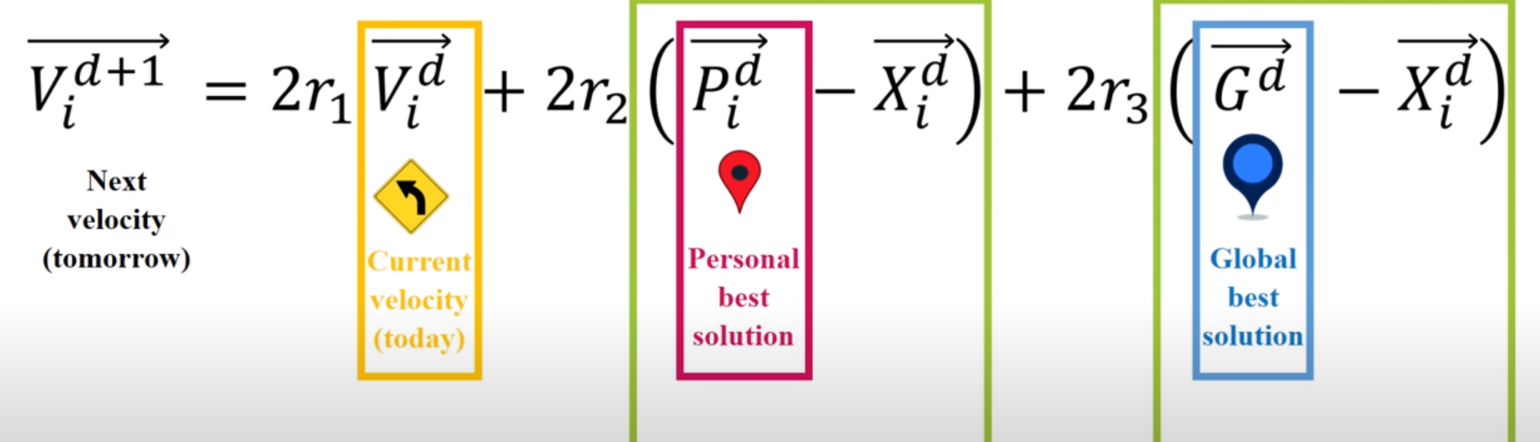
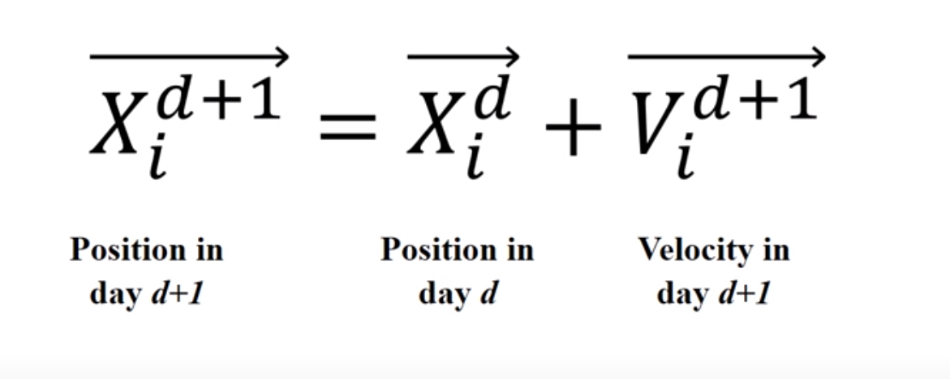
1. Particle Swarm Optimization (PSO)
Mathematical Model of PSO search strategy
Distance to the Personal Best
Distance to the Golbal Best

Slide 10
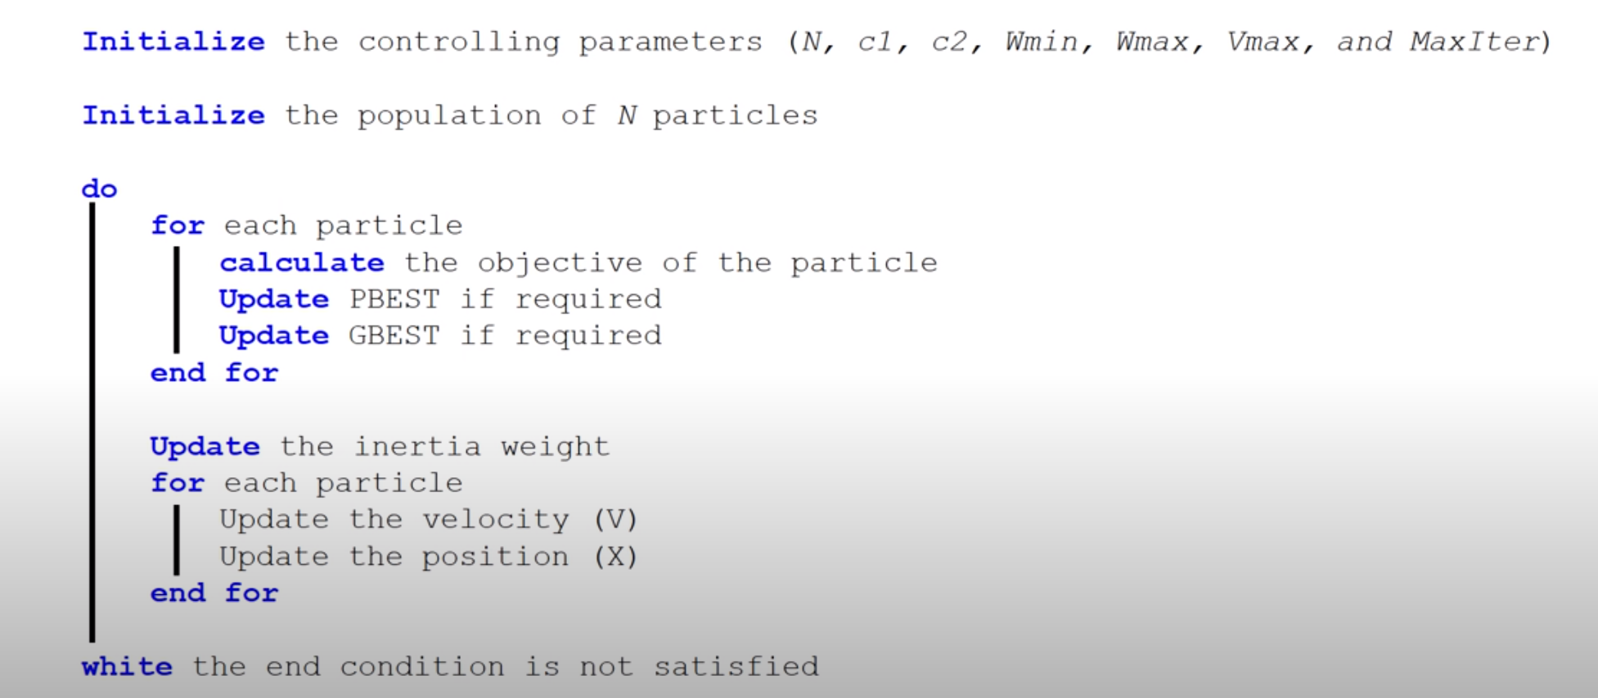
1. Particle Swarm Optimization (PSO)
Algorithm of PSO search strategy
Return the Best Global Position !

Slide 11
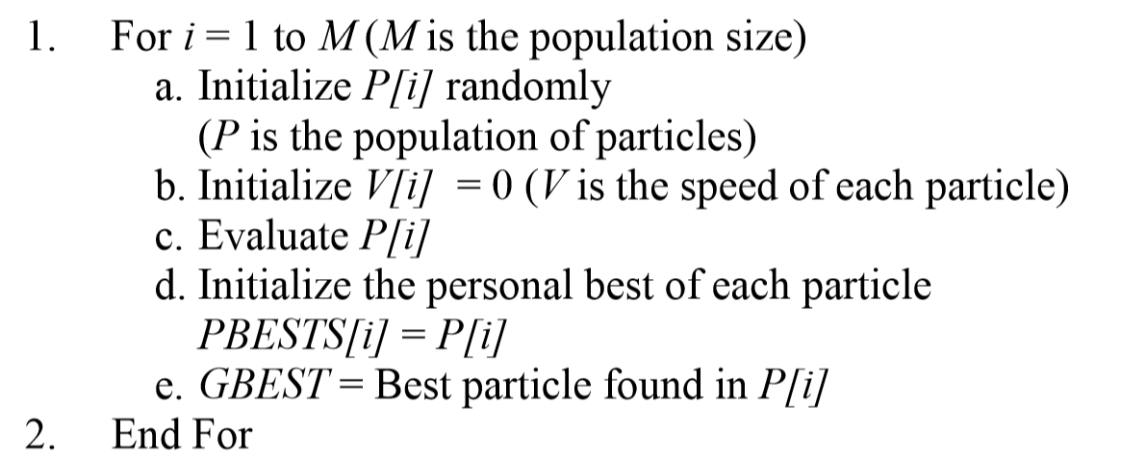
2. Multi-objective Particle Swarm Optimization (Algorithm)
Notes:
Initialize particle i randomly
Initialize speed for all particles as 0
Initialize the personal best for each particle is P[i]
Store all the non-dominated P[i] in the global best archive

Slide 12
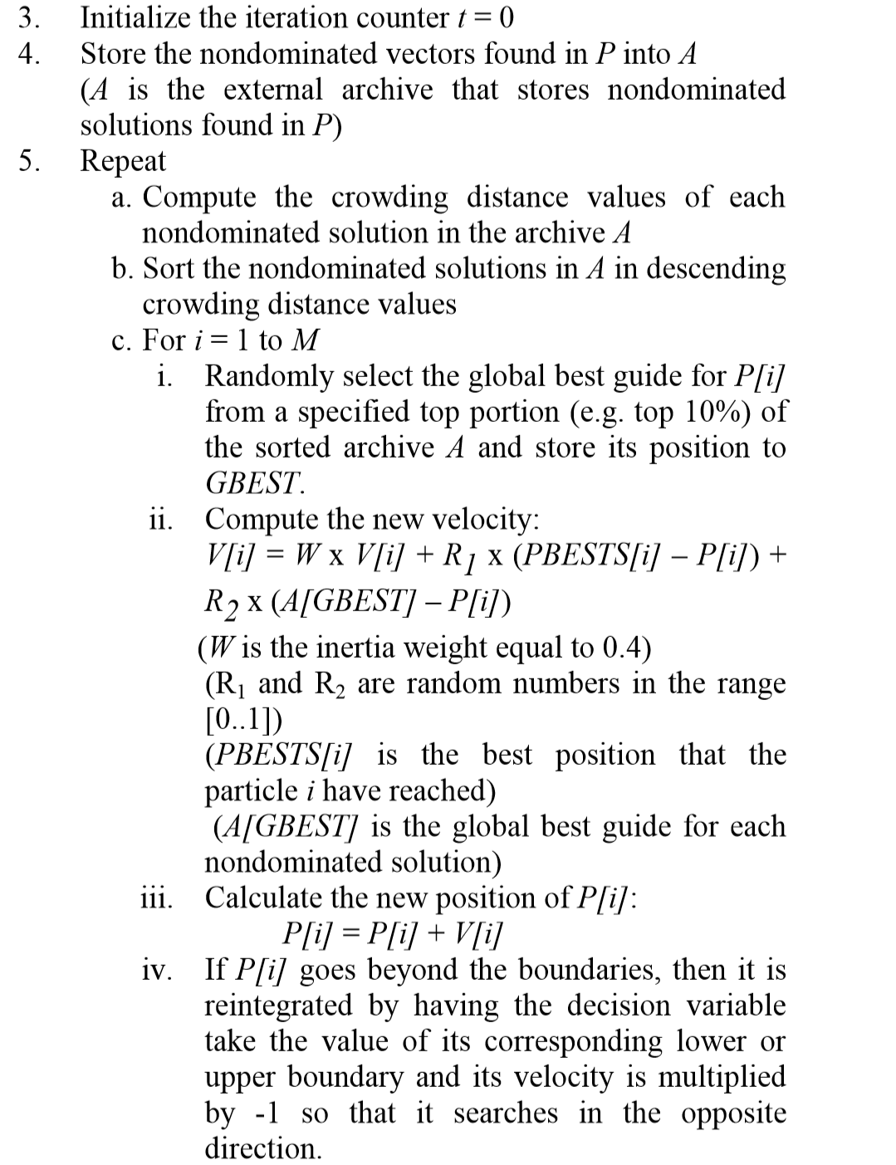
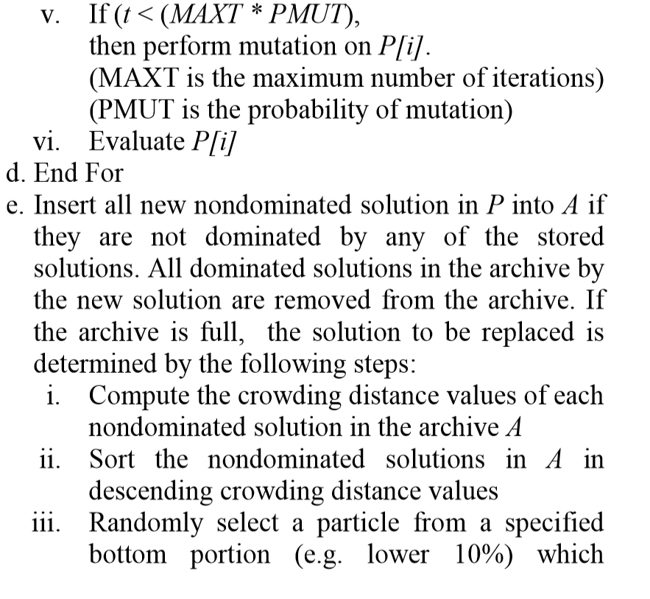
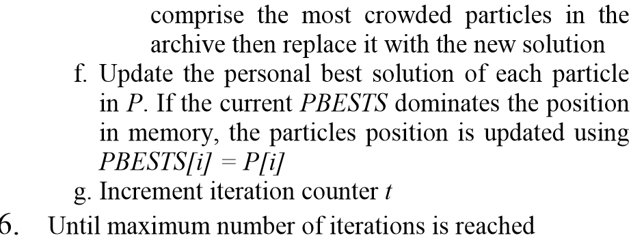
Notes:
Crowding distance: average distance to its neighbors
!!Well distributed non-dominated solutions & converge to the Pareto front
mutations>preventing premature convergence due to existing local Pareto fronts in some optimization problems.

Slide 13
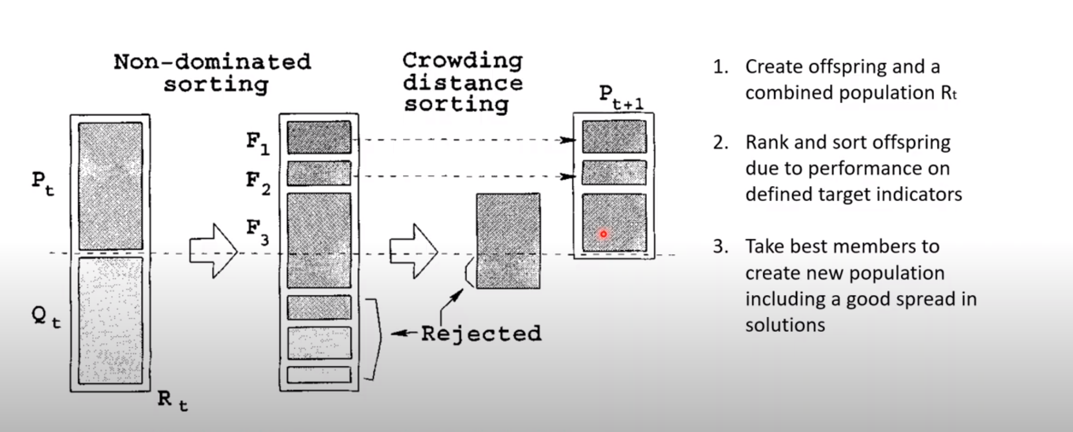
3. Quick review of NSGA II
Notes:
Qt has same number with Pt, crossover and mutation
F1 rank is 1, F2 rank is 2
Decreasing sort of crowding distance -> need to cover the whole frontier

Slide 14
4. MOPSO vs NSGA II
MOPSO:
PSO was designed for single objective optimization. It has been extended for multi-objective solutions with elitism, diversity operators, mutation operators, and constraint handling.
Cover the entire Pareto front
Superior execution time
Superior in converging to the true Pareto front
NSGA II:
These EAs are population-based algorithms which allow them to explore the different parts of the Pareto front simultaneously (Diversity)
Handle more types of variables
R codes : /home/k2uxam/Doc/nsga_vs_pso.R
Notes:
*to generate the best set of nondominated solutions close to the true Pareto front in all test functions except in one function where NSGA-II is superior.
*In terms of diversity of the nondominated solutions, NSGA-II produced the best results in all test functions but was not able to cover the entire Pareto front in all test functions. MOPSO was the only algorithm which was able to cover the entire Pareto front. (cover entire pareto)
*This shows that while MOPSO is superior in converging to the true Pareto front, its diversity mechanism falls behind that of NSGA-II. (less diversity compare to nsga2)
*The computation time of the algorithms was also observed and MOPSO has been found to have a vastly superior execution time compared to the other algorithms. (time)

Slide 15
Continue: MO-MetaLearning

